Slide 1
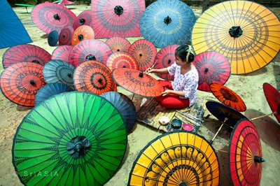
Working with Expatriate in a competitive environment
PWINT OO SWE
MARKETING AND COMMUNICATION DIRECTOR

Slide 2
Pwint is an energetic, focused and committed Manager with more than 15 years in FMCG and communications industry since 1998. Over the years of her career, she has dedicated herself on understanding consumer insights, channel development and brand building with International and local Networks, Media Networks and business community. Every passing day she takes as new learning.
Pwint Oo Swe
Current Position :
Marketing and communication Director @ Ooredoo Myanmar
Founder of Myanmar Professional Marketer Association
Part-time Teacher of Business Planning and marketing Management @ UMFCCI and BCB
Favorite Sport: Yoga, Kick Boxing & hula hoop
Favorite Moment : Quality time with my Yuki and SPA
Favorite Movie : Gravity, Life is beautiful, Notting Hill, The Bang Bang Club, and many more….
Future inspiration: Couching Future leader and contribute back to society

Slide 3
Working with Expatriate?

Slide 4
Effective Communications

Slide 6
Commitment
Most people fail, not because of lack of desire, but because of lack of commitment

Slide 7
Find Mature Interest

Slide 8
Culture Awareness
West
East
Logical Thinking
Rational
Left Brain Oriented
Analysis
Against Nature
Materialism
Fuzzy Thinking
Emotional
Right Brain Oriented
Synthesis
Compromise Nature
Spiritualism

Slide 9
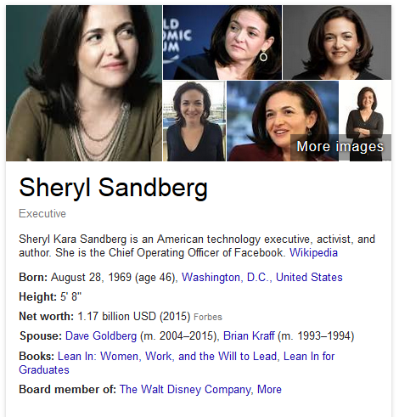
Women in Cooperate life
Lean In: Women, Work, and the Will to Lead
It’s incredibly difficult to manage both career and motherhood, even before you give birth.
She points out that men still run the world.
She gets it about women’s compensation.
We lower our own expectations of what we can achieve,”
Women should ask their partners to do at least half the parenting work.

Slide 10
Self Measuring stick
Do I know what is expected of me at work? (Do my team members have clear job descriptions, and clarity around projects, tasks and expectations).
Do I have the materials and equipment I need to do my work right? (Have they got the resources they need to succeed in their role?)
Do I have the opportunity to do what I do best everyday? (Do you have people in the right jobs, where they can use and build on their strengths?)
In the last 7 days, have I received recognition or praise for doing good work? (When was the last time you gave praise to the individuals in your team? If it wasn't in the last week, it's not regular enough. People crave recognition - your role as leader is to encourage and cheer-lead your team.)
Does my supervisor or someone at work seem to care about me as a person? (Do you know who your team members are as people, not employees?)
Is there someone at work who encourages my development? (Do you provide opportunities for your staff to learn new skills and feel like they are moving forward?)
At work, do my opinions seem to count? (People leave managers, not jobs. What structure do you have in place for your team members to provide their feedback? And do you listen when it's given?)
Does the mission / purpose of my company make me feel my job is important? (Do your team members know how their role fits into the bigger picture?)
Are my co-workers committed to doing quality work? (Are you letting poor performers set the standard or are you encouraging people to lift the bar? The standard your walk past is the standard you set. Good performers can be demoralised if poor standards are accepted in others.)
Do I have a best friend at work? (Are you providing opportunities for your team to grow supportive relationships at work? Work is a big part of their lives, so it's vital for people to have fun and friendship.)
In the last 6 months, has someone talked to me about my progress? (Are you providing regular reviews and feedback to help people with a sense of direction at work?)
This last year, have I had the opportunity at work to learn and grow? (Are you providing opportunities for advancement?)

