Slide 1
Market Yourself
Htun Htun Naing @ Nelson
17th October 2015
Chatrium Hotel, Yangon

Slide 2
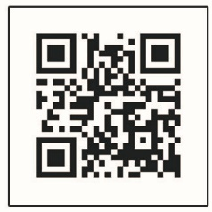
WHO AM I

Slide 3
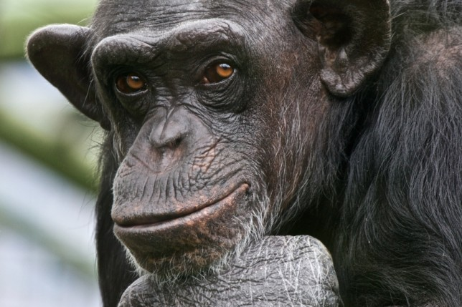
WHO ARE YOU
Identify current stage
What did you learn ?
What did you achieve ?
Are you in line with your road map ?

Slide 4
WHAT IS MARKET
Meeting point for

Slide 5
WHAT DO YOU WANT TO SELL

Slide 6
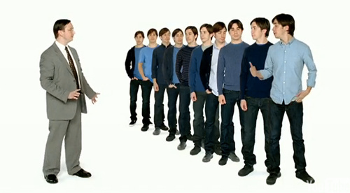
WHAT TO DO
“Package yourself “
“Build your brand “
“Socialize your brand “

Slide 7
HOW TO DO
Define unique qualities about you
How would you tackle an overwhelming challenge with your skills?
What are your weaknesses? How would you deal with it in a critical situation which makes you want to give up?
List your strengths? What skills would you like to acquire but have not had the opportunity yet?
What is the career stream that you want to get into?

Slide 8
Today we use

Slide 12
ENTREPRENEURS
Distinguished between risk, which is insurable, and uncertainty, which is not
discovers unknown market opportunities

Slide 13
Ten Ways to Fail Entrepreneurship
Management mistakes
Lack of experience
Poor financial control
Weak marketing efforts
Failure to develop a strategic plan
Uncontrolled growth
Poor location
Improper inventory control
Incorrect pricing
Inability to make the “entrepreneurial transition”

Slide 14
Don’t afraid to FALL, Its will UP again

Slide 15
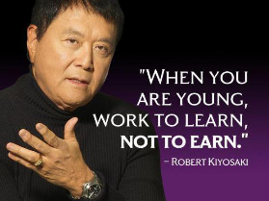
My Favourite Quotes

Slide 16
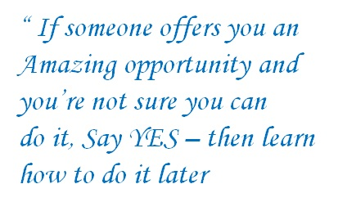
My Favourite Quotes

Slide 18
HHNaing
HtunHtunNaing
hhn@blueoceanmgt.com

