Slide 1
S
pirit of Entrepreneurship

Slide 2
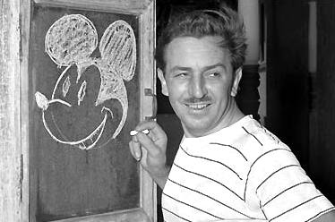
W
hy Entrepreneurship?

Slide 3
W
hy Entrepreneurship?

Slide 4
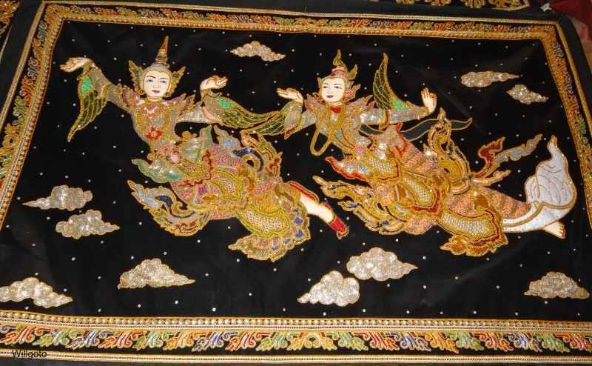
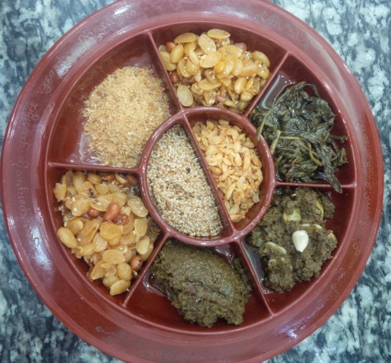
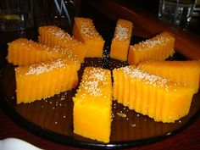
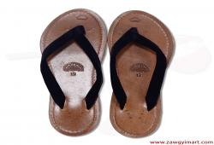
W
hy Entrepreneurship?
MANDALAY

Slide 5
Russia
France
Myanmar
Belgium
Vietnam
Japan
Indonesia
Switzerland

Slide 6
W
hy Entrepreneurship?
ASEAN
98% SME
Myanmar
9 out of 10

Slide 7
W
hy Entrepreneurship?

Slide 8
W
hat is Entrepreneurship?

Slide 9
W
hat is Entrepreneurship?
XYZ

Slide 10
W
hat is Entrepreneurship?
Best Quality
XYZ

Slide 11
W
hat is Entrepreneurship?
Best Quality
XYZ
Lowest Price

Slide 12
W
hat is Entrepreneurship?
Best Quality
Main Entrance
Lowest Price

Slide 13
H
ere comes the Entrepreneur !
Best Quality
Main Entrance
Lowest Price

Slide 14
E
ntrepreneur
Leads
Takes risks
Exercises initiative
Takes advantage on market opportunities
Plans, organizes, employing resources
Innovates new or improves existing products

Slide 15
C
an anyone become Entrepreneur ?

Slide 16
W
ill everyone choose to become an Entrepreneur ?

Slide 17
W
hy are the answers different?

Slide 18
Factors
Entrepreneur
Employee
Income
Working Hour
Balance in life
Future
Uncertain
Unlimited
Work more
Uncertain
Fixed
Limited
Can balance
Foreseen

Slide 19
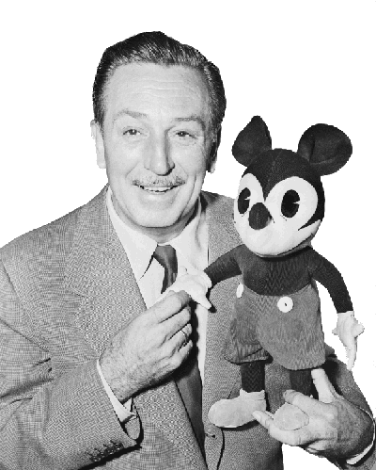
What matters entrepreneurs?
To show who you are
To build something great
To share value
Not just to make money

Slide 20
P
ersonality Traits – humble beginning
Passion
Risk-taking
Curiosity
Optimistic
Persistent
Decisive
Focus

Slide 21
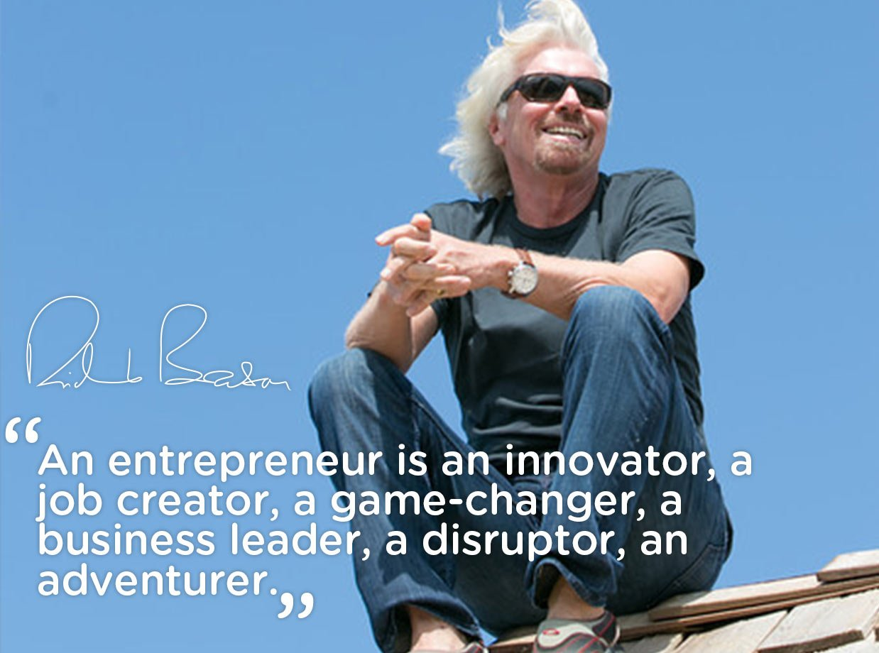
Richard Branson
Virgin Group
Passion to Cognition

Slide 22
Risk Taking to Risk Calculating

Slide 23
Curiosity to Creative

Slide 24
Bezos
Optimistic to Positive

Slide 25
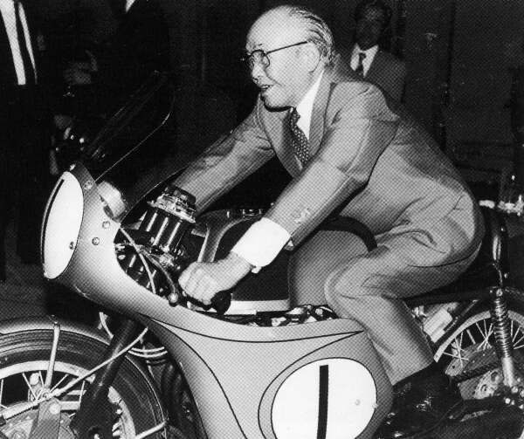
Mr. Honda Persistent to Perseverance

Slide 26
Debbi Fields
Decisive to Executive

Slide 27
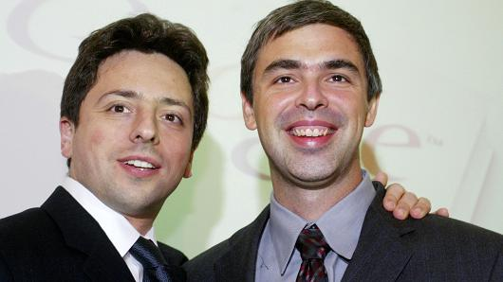
Sergey Brin & Larry Page Focus to Adaptability

Slide 28
P
ersonality Traits – ultimate success
Passion to Cognition
Risk-taking to Risk-calculating
Curiosity to Creativity
Optimistic to Positive Attitude
Persistent to Perseverance
Decisive to Execution
Focus to Adaptability

Slide 29
Successful Entrepreneurship
Developmental Process
Life-long learning model

Slide 30
Developmental Process
Growth
Startup
Creative Applications
Competency Awareness
Career Opportunity

Slide 31
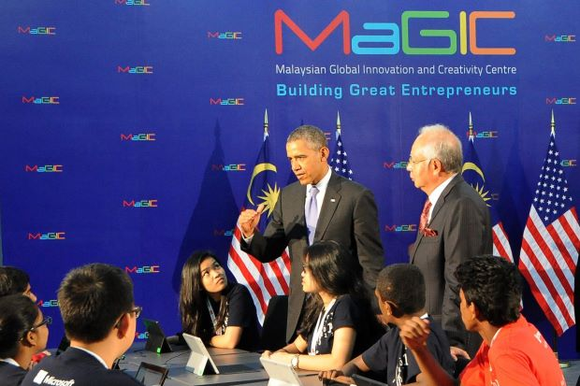
Why young entrepreneurs?

Slide 32
Youth Entrepreneurship
Gallup Study on High School Students
80% of would be entrepreneurs- 18-34
7/10 want to start their own companies
70% of 14-19, 40% 9-12- to be entrepreneurs

Slide 33
Youth Entrepreneurship
Gallup Study on High School Students
75% new jobs by SMEs
90% failed soon after start-up

Slide 34
Youth Entrepreneurship
education
Developmental Process

Slide 35
Sum-up
Not “born”, just “become”
Beyond “owner”, just “your identity”
Diversity in personal characteristics
Developmental process- life long learning
A series of different challenges at all stages
Major source of new jobs in the economy

Slide 36
What major did you choose after matriculation?

Slide 37
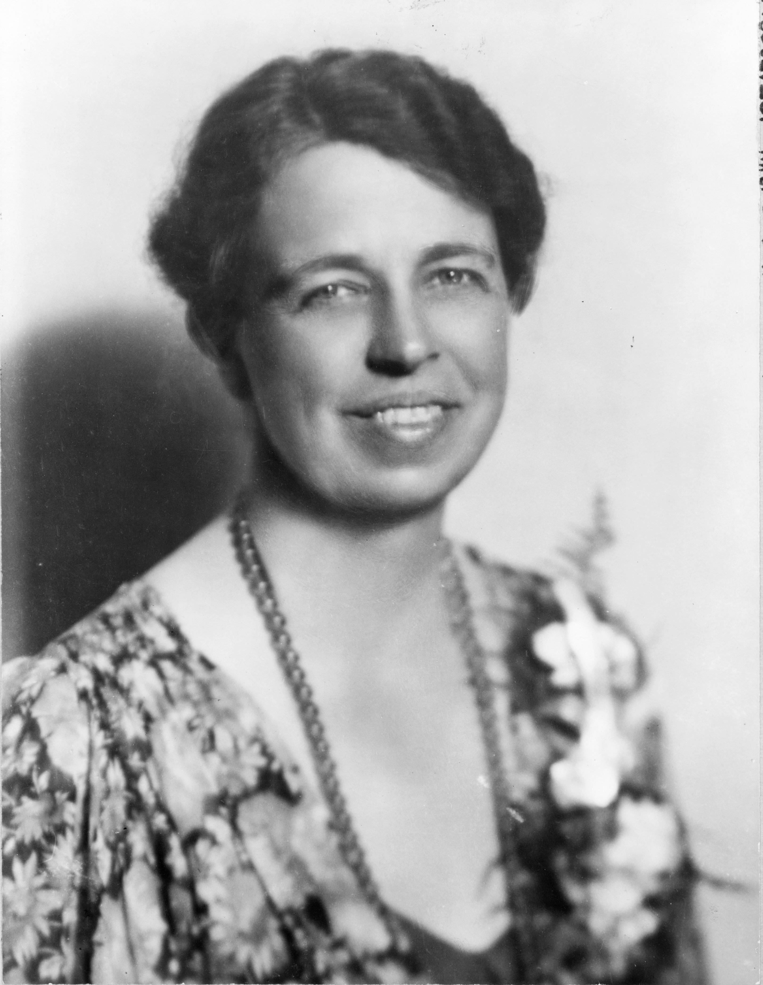
Eleanor Roosevelt
“The future belongs to those who believe in the beauty of their dreams.”

Slide 39
References
http://www.inc.com/zoe-henry/marcus-lemonis-joe-nocella-718-cyclery.html
http://dougleschan.com/the-recruitment-guru/quotes-2/60-inspirational-quotes-for-entrepreneurs-quote-quotes/

Slide 40
Thank you.

