Slide 1
Millennials 2.0 Youth, Innovation and Success
Dr Tun Thura Thet
CEO
Myanmar Information Technology

Slide 2
Today’s Topic

Slide 3
Who are Millennials?
Persons reaching young adulthood around the year 2000.
“The industry brims with theories on what makes millennials tick."

Slide 4
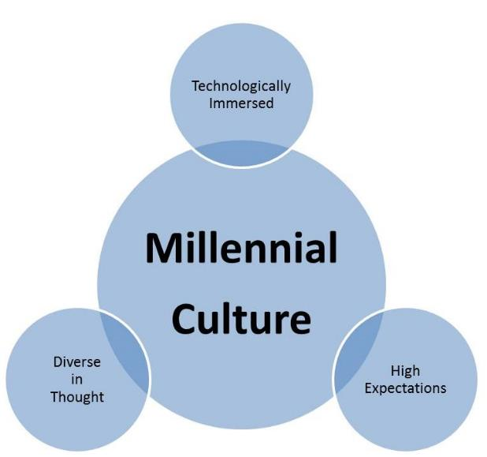
What About Millennials

Slide 5
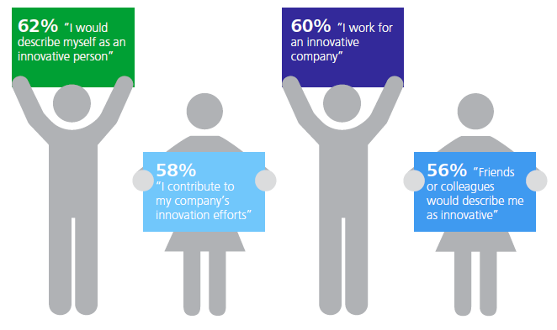
Millennials love innovation

Slide 6
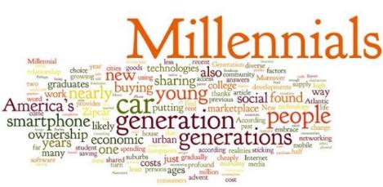
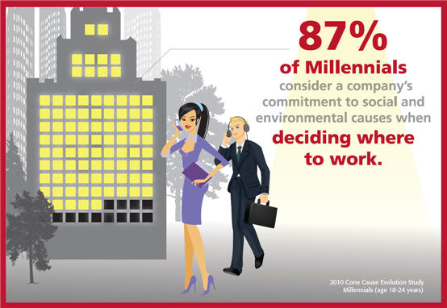
Social and Environmental friendly

Slide 7
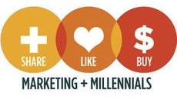
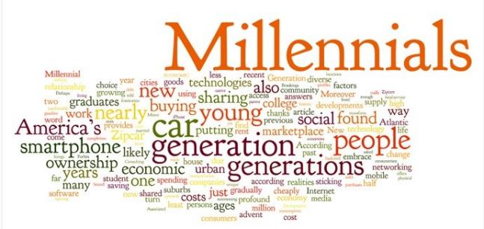
Millennial Consumers
Know
Me
Empower
Me
WOW
Me
IWIC – Incredibly Well Informed Consumers
Prosumer – Producer and Consumer of Contents

Slide 8
Millennial Entrepreneurs
71% are interested in becoming Entrepreneurs
55% want to start own business this year
75% of all new jobs are created by Entrepreneurs
23% become entrepreneurs as a result of unemployment
Less than 1% of them come from extremely rich or poor families
Source: Entrepreneur.com

Slide 9
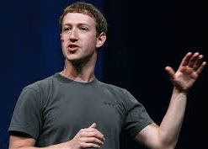
Millennial Entrepreneurs
Mark Zuckerberg
Founder and CEO of social networking website Facebook
Net Worth $33.1 billion
Born May, 1984
(Harvard dropout)

Slide 10
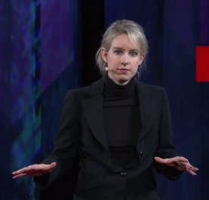
Millennial Entrepreneurs
Elizabeth Holmes
America's Youngest Female Billionaire Explains How She's Transforming Medicine
Net Worth $4.5 billion
Born Feb, 1984
(Stanford dropout)

Slide 11
Teen Millionaires
Yahoo Buys
News App From British Teenager
For $30 Million
Nick D’Aloisio, 17, of Britain, developed his news-reading app when he was only 15.

Slide 12
What is Entrepreneurship
IDEAS are important.
But, they are cheap and plenty.
What is precious is an IDEA with PASSION.
You need not to worry about people stealing our IDEAS.
One can steal your ideas but never your PASSION.

Slide 13
Thinkers
Visionary & Idea Generator
Unafraid of Failures
Think Outside-the-box
Unconstrained by Feasibility
Disruptive Ideas & Technologies

Slide 14
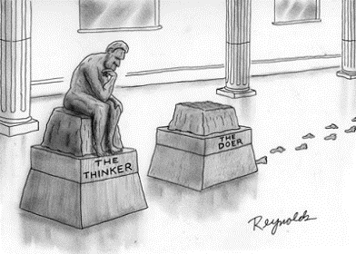
Doers
Pragmatic and Realistic
Action-oriented
Capable achieving ambitious goals
Focused and determined
Good motivator to self and others

Slide 15
Movers, Shakers and Shapers
Movers
Takes Initiatives
Proactive to Change
Shakers
Highly Influential
Vocal and Articulated
Shapers
Mentors and Coaches
Inspiration

Slide 16
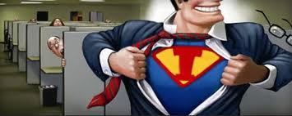
Intrapreneurship (Internal Entrepreneurship)
Implementation of startup practices within a large organization producing valued innovation.
Successful adaptation of entrepreneurial attitudes and strategies inside a large organization.
A kind of a Special Economic Zone
Rovio Entertainment
244 M Revenue

Slide 17
MEGA Technological Trends
Social
Mobile
Cloud
Big Data

Slide 18
Facebook and Myanmar

Slide 19
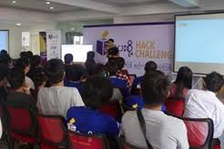
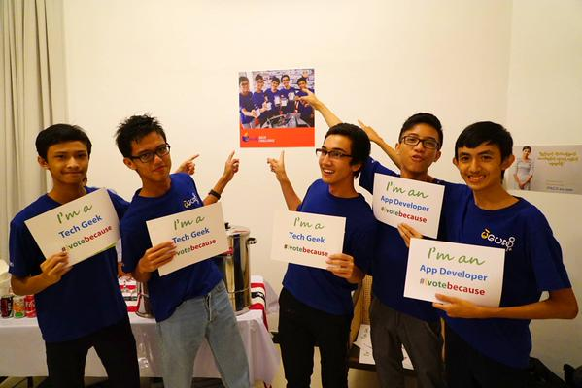
Hack Challenge Myanmar

Slide 20
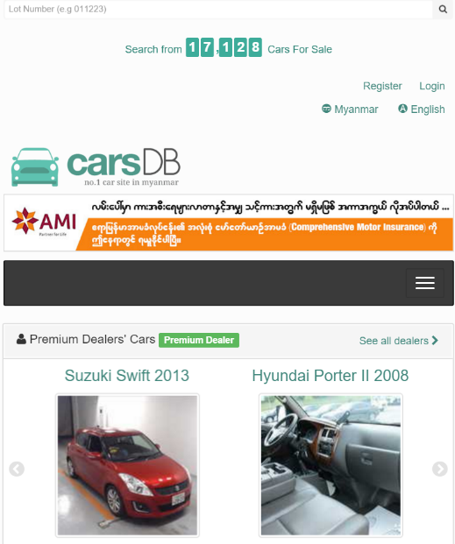
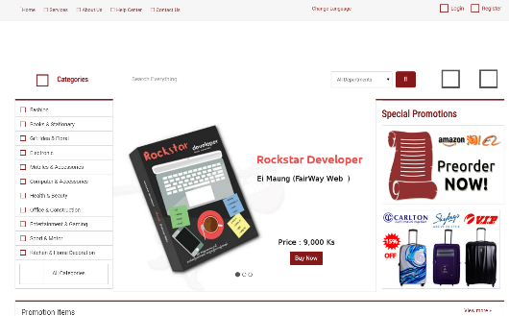
More Myanmar Stories

Slide 21
E-Commerce
Daily Sales
469B 1,285M
61B 167M
56B 156M
100 computers per minute

Slide 22
E-Commerce Trends
E-Commerce
M-Commerce - Mobile
S-Commerce – Social
Omni Channel

Slide 23
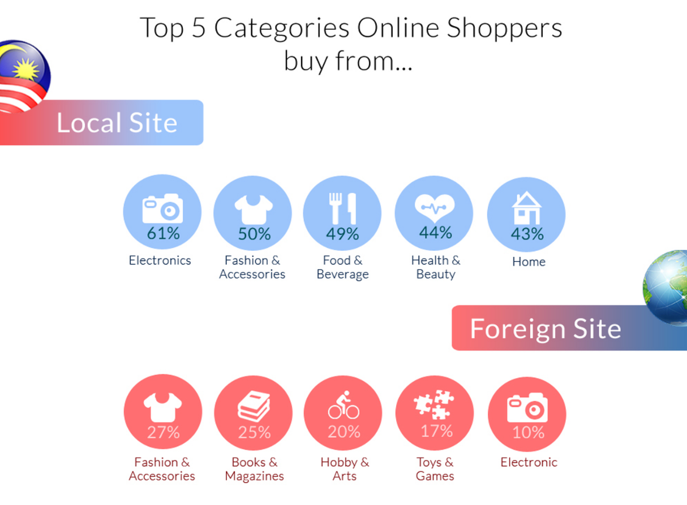

Slide 24
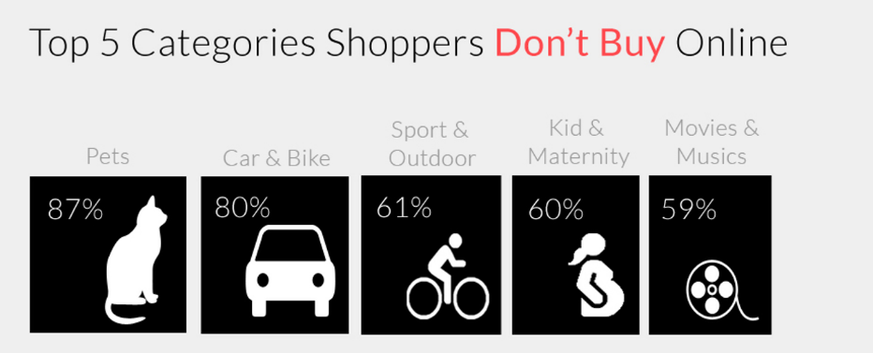

Slide 25
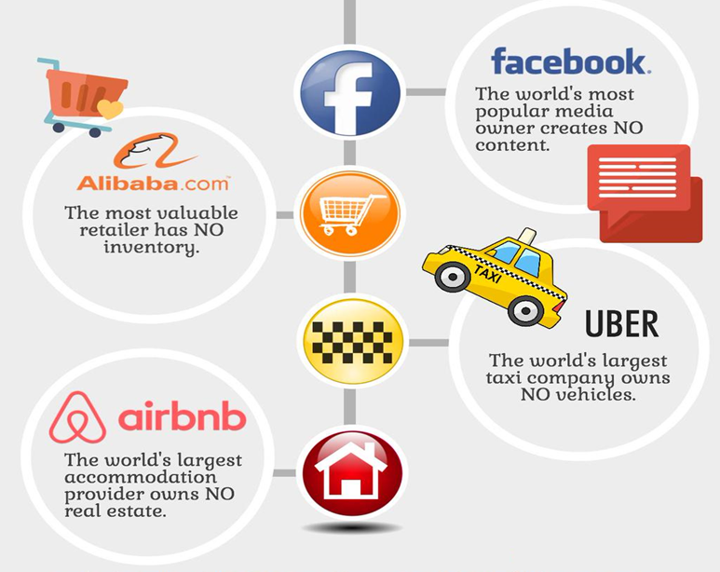

Slide 26
Breaking the Code of Success
Understand your target Market and Users
Focus on your Strengths
Be Brave but Wise
It is all about Teamwork not Group-work
“the Result” matters, not “the excuses”
Remember we need DOERs

Slide 27
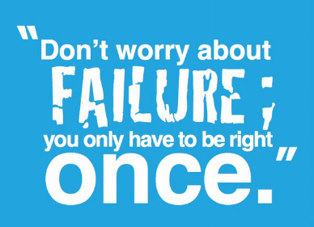
Rounding Up
Entrepreneurs are - Self-made Founders.
Entrepreneurship is about - Idea + Passion

Slide 28
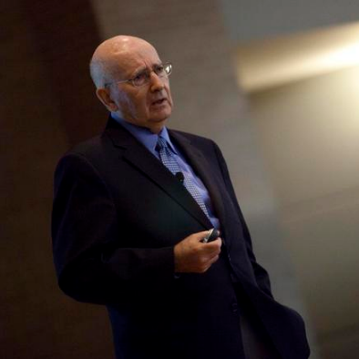
Youth
+
Innovation
=
Success
Philip Kotler
Yangon, 2014

