Slide 1
How To Market Yourself
In a Competitive World
Myint Zaw President and founder- Professional Marketer Association CEO and Chief Consultant – Ground Solution Co.ltd

Slide 3
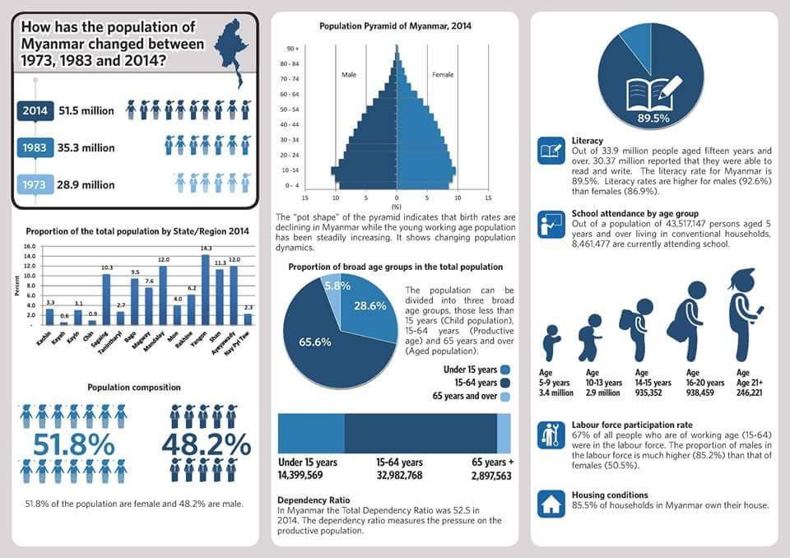

Slide 5
Popular Mobile Activities
What Are People Doing on Their Mobile Devices?
Social Networking
Performing Searches
Listening to Music
Using Mobile Apps
Browsing Websites
Watching Videos
Sending and Reading Emails
Checking News and Weather
Sending and Reading Text Messages

Slide 6
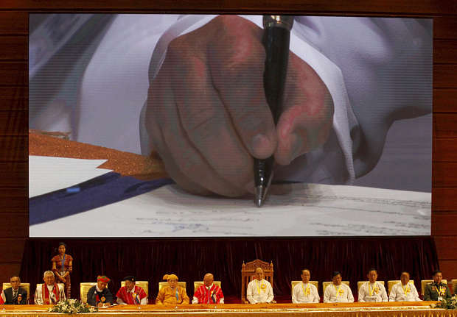
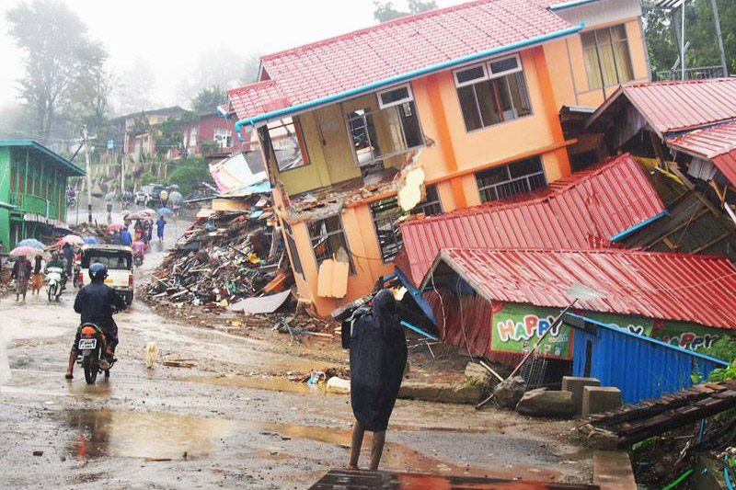
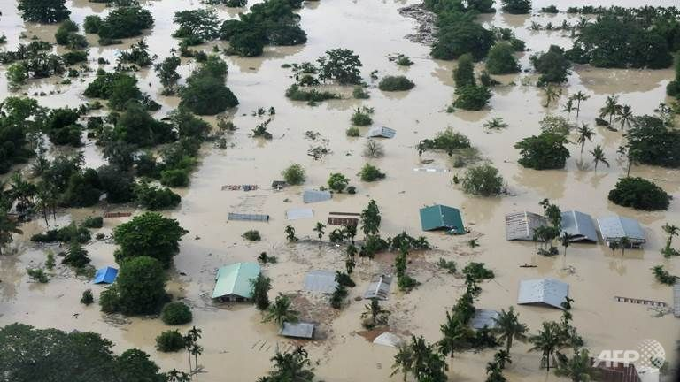
What have changed these Years

Slide 9
E
Importance For Myanmar
Proud to be “Myanmar”
E l e c t i o n
PEACE TALK
CAPITAL MARKET
ASEAN Economic Community
International Recognize
2015: international endorsement
Chairing ASEAN
Accept & Respect
2014 : Cooperation & Leadership
27th SEA Game
Knew about Myanmar
2013: Myanmar Teamwork & Capabilities
Tried ,Interested
2012 : Myanmar’s moments , interested to Try
Noticed
2011: some positive Changes & want to Know more
Heard of it.
In 2010: watch and see what happen next ?
Nowhere
Before 2010: most people doesn't really know Myanmar

Slide 11
MOST DIFFICULT POSITIONS TO FILL
VACANCIES SURVEYED BY POSITION
Popular Position | Ranking
Sales & Marketing | 1
Business Development | 2
Finance and Accounts | 3
Engineers & Technicians | 4
HR | 5
Admin & Support | 6
Others | 7
IT | 8
Travel & Tour | 9
2013 VACANCIES SURVEYED
DATA SOURCE : THE OPPORTUNITY JOURNAL

Slide 12
6.1.1 RECRUITING
Q. Do you have any problems filling in job vacancies
94%
6%
Having difficulty finding the right people.
Not much problem
finding the right people
Senior Management and Management level are the most difficult to find.
REASONS FOR DIFFICULTY FILLING JOBS
Employers have many reasons behind their difficulty to fill jobs, ranging from competency and quality of the candidates, to candidates looking for more pay than employers were offering.
However, our survey and experience reveals one of the two most frequently reported reasons why employers say they have difficulty filling vacancies is a simple lack of available qualified applicants in the local labor market.

Slide 13
Q. What are the skills lacking in most of the staff / ex-staff you have encountered?
TOP SKILLS THAT EMPLOYERS WANT
1 | Global Skills | Language ability to speak and understand other language and culture.
2 | Computing Skills | Weak in Word processing , presentation, using database, basic applications etc.
3 | Initiative | Weak to act on initiative, proactive in giving ideas and solutions
4 | Action Planning | Needing direction to decide what is needed to achieve and succeed
5 | Critical Thinking | Lacks the determination on the best course of action, based on logic and fact
6 | Professionalism | Needs development in attention to quality in the work they do.
7 | Enthusiasm | Continues learning for now and future roles
8 | Management | Able to motivate and direct others
9 | Stress Tolerance | Cannot handle pressure

Slide 14
SWOT Analysis
Strengths
Weakness
Great experience for national employee
New Industries ,New Learning
Higher Pay ,Bigger Title
Easy to shift jobs
Employee Market
Brain Gain
Chasing Money ,Chasing Salary
Weak Communication & Cooperation
Lack of Long term vision & Impatience
Surface knowledge, not enough depth
Inability on meet up coming market
challenges and demand.
Required Service Oriented Mindset
Employee’s SWOT
Myanmar continues as up trend
Big MNCs are yet to come
ICT & Telecom boost
Capital Market to Introduce
AEC- Asean Beyond 2015
.
Cant meet the expectation in long term
Require different set of skill & Knowledge
Human Capital will exposes to Others
Professionalism & Ownership mindset
SOMEBODY MIGHT TAKE YOUR PLACE & OPPORTUNITIES !
Opportunity
Threats

Slide 15
Business Protection Management (BPM)
The concept of BPM is to covering defensive walls to protect the business and stakeholders’ well-being.
These walls are as follows;
Standard Operation Procedure (SOP)
Enterprise Risk Management (ERM)
Business Continuity Management (BCM)
Insurance coverage

Slide 16
Dream
Vision
Mission statement :
Want
Maintain?
New challenges?
Set new target?
Next ?
Now
SWOT analysis
Ideal situation
Insight
Job/life
Ensure
Arrival
Planning Vs Actual
Things to adjust
Have you get what we want?
SMART
Issues/barriers
What can go wrong FAQs
How
Need
Man power
Time
Cost
Plan B,C

Slide 17
Your Call Objectives must be SMART . . .
S
Specific
M
Measurable
A
Achievable
R
Relevant
T
Timed

Slide 18
Be Professional + Ethical
Think what YOU really want to in be….
Check is this your Want or Others demand..
Decide, then Focus , learn beyond work beyond book , LOVE IT!
Specialize ,Differentiation and Apply at all time..
When your JOB become part of you & your are Enjoying ,then
Put HEART in front and Share Others for their benefit
With Wisdom ,..you are Professional

Slide 19
Speed to Market &
Depend on proper strategic planning
How far & fast can you respond Market demand

Slide 20
Thanks You

