Slide 1
Internet of things Internet as services / distributions / ecommerce

Slide 4
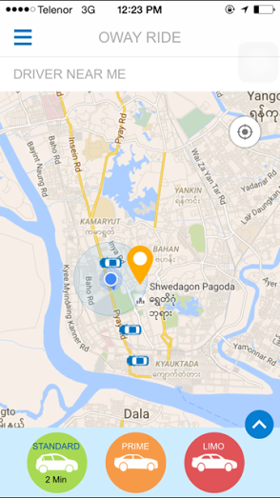
Oway Ride is a mobile apps that is specifically designed to provide secure private driving experience for consumers and corporate uses in Myanmar – leveraging our experience with managing fleet and car rental network across all major and second tier cities in Myanmar.
.
Features include ability to call operator (24/7) via our apps, verifying passengers to control experience, extensive due diligence on drivers (we call partners), the ability to search in Myanmar Language for maps and addresses, a unique dispatch system that can coordinate across all network.

